Slide 1
APUSH Review: Technology and Transportation During The Market Revolution
Everything You need to know about technology and transportation during the market revolution to succeed in apush

Slide 2

The Market Revolution
What is it?
Revolution in transportation, farming, and production of goods
Increase use of canals, roads, steamboats, and RRs
Switch from subsistence to cash-crop farming
Goods were produced increasingly outside the home
Occurs PRIOR to the Civil War (Antebellum America)

Slide 3
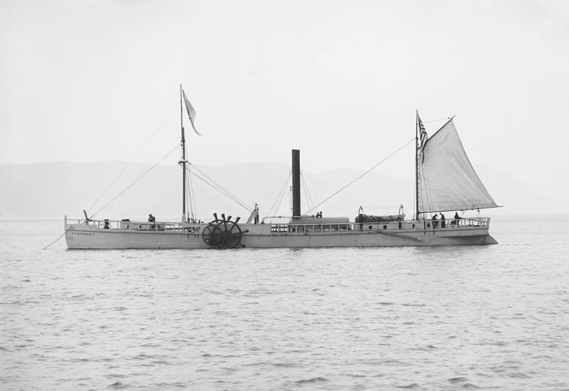
Transportation Improvements
Roads - Cumberland (National) Road
Connected MD to OH
Funded by the federal government (interstate)
Canals - Erie
363 miles - Albany to Buffalo
Paid entirely by NY (intrastate)
Steamboat
Robert Fulton - boats could travel AGAINST the current

Slide 4
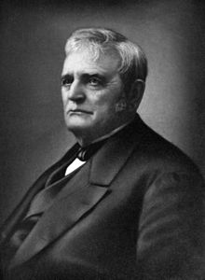
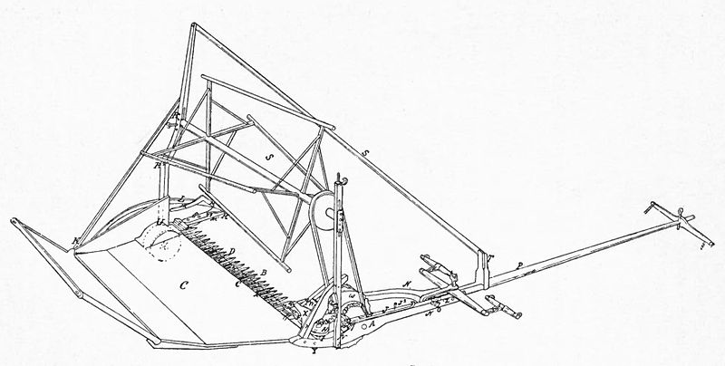
Agricultural Improvements
Cotton Gin:
Eli Whitney
Drastically increased cotton production and demand for slaves
Steel plow:
Farmers could break soil more easily
Benefitted the Midwest
McCormick Reaper:
Farmers could harvest crops more quickly
Increased efficiency of harvesting

Slide 5
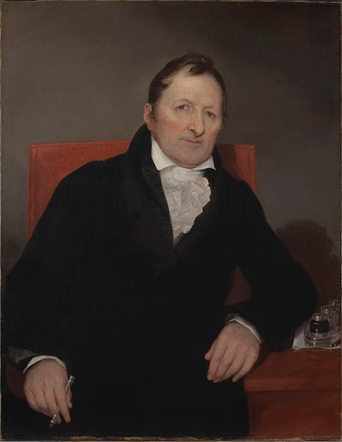
Technological Improvements
Interchangeable Parts:
Eli Whitney
“Cookie cutter” parts
Mass production of goods - increased production and efficiency rates
Telegraph:
1844 - “What hath God wrought?”
Increased communication in the US

Slide 6
Test Tips
Multiple-Choice and Short Answer
KNOW specific inventions and be able to explain the impact (by region as well)
Essay:
Part of broader essay about the Market Revolution and regional specialization

Slide 7
That’s It!
Thanks for watching
Good luck in May!

